Slide 1
Digital Portfolio
STUDENT NAME: Latha p
REGISTER NO AND NMID: 222401248,asunm1102ai138
DEPARTMENT: B.Sc with AI
COLLEGE: Dharmamurthi Rao Bahadur Calavala Cunnan Chetty Hindu College,Madras university.

Slide 2
PROJECT TITLE
Student webpage portfolio

Slide 3


AGENDA
Problem Statement
Project Overview
End Users
Tools and Technologies
Portfolio design and Layout
Features and Functionality
Results and Screenshots
Conclusion
Github Link
3/21/2024 Annual Review

Slide 4

PROBLEM STATEMENT
I created this website to solve a fundamental challenge for any aspiring professional, especially a student: visibility and credibility.
Stand Out: As a Computer Science student, you need a way to distinguish yourself from peers in a highly competitive field. A resume alone is often not enough.
Showcase, Don't Just Tell: You need a platform to visually demonstrate your skills, projects, and experience, proving your capabilities rather than just listing them.
Centralized Professional Presence: The website serves as a single, central hub where potential employers, clients, or collaborators can find everything they need to know about you—your work, your skills, and how to contact you.
Practical Application: Building the portfolio itself is a project that demonstrates your proficiency in front-end development (HTML, CSS, JavaScript, Tailwind CSS) and UI/UX design.

Slide 5

PROJECT OVERVIEW
This is a responsive, single-page portfolio website built with modern web technologies. It is designed to be visually appealing, performant, and user-friendly.
The site introduces me, showcases my academic and professional journey, highlights my technical projects, details your skills, and provides a means for visitors to contact me.

Slide 6

WHO ARE THE END USERS?
The primary end users of this website are:
Potential Employers: Recruiters and hiring managers looking to assess my technical skills, experience, and cultural fit.
Client Prospects: Individuals or businesses looking to hire a freelancer for development work.
Collaborators: Other developers or designers interested in working on projects together.
Academic Peers & Professors: To share my work and achievements within my academic network.

Slide 7

TOOLS AND TECHNIQUES
Category | Technologies Used
Core | HTML5, CSS3, JavaScript (ES6+)
CSS Framework | Tailwind CSS (via CDN)
Icons | Font Awesome (v6.4.0)
Fonts | Inter (from Google Fonts)
Deployment

Slide 8
PORTFOLIO DESIGN AND LAYOUT
The design follows a modern, clean, and professional aesthetic with a focus on user experience Visual Effects:
Glass Morphism: Used on buttons for a modern, translucent effect.
Animated Particles: Floating shapes in the hero section background add depth and dynamism.
Smooth Animations: Elements fade and slide into view as the user scrolls (using the Intersection Observer API).
Hover Effects: Cards and buttons have smooth lift and shadow transitions on hover.
Layout: The site is structured as a single page with a fixed navigation bar for easy section jumping. The layout is fully responsive, adapting seamlessly from mobile to desktop views.
Section Flow:
Hero: Full-screen introduction with a profile photo, name, title, and call-to-action buttons.
About: Personal bio, key stats, and education/achievement highlights.
Projects: Grid of featured projects with images, descriptions, and tech stacks.
Experience: A timeline-style layout of professional and academic roles with detailed accomplishments.
Skills: Categorized progress bars for frontend, backend, and tools/DevOps skills.
Contact: A contact form and direct contact information with social media links.
Footer: A simple footer with a repeat of your name and social links.
8

Slide 9
FEATURES AND FUNCTIONALITY
Responsive Navigation: A fixed navbar that changes style on scroll. Includes a hamburger menu for mobile devices with a smooth slide-in animation.
Smooth Scrolling: Clicking navigation links smoothly scrolls to the respective section.
Typing Animation: The "Computer Science Student" text in the hero section is typed out dynamically. Scroll-Triggered Animations: Elements use CSS classes and JavaScript to animate into view when they enter the viewport.
Interactive Project Cards: Project cards feature an overlay with links that appears on hover.
Animated Skill Bars: The skill progress bars fill to their specified percentage when the Skills section is scrolled into view.
Interactive Contact Form: A fully designed form with validation and a simulated submission process that shows a loading state and a success notification.
Mobile-First Design: The entire site and its interactions are fully functional on mobile devices.

Slide 10
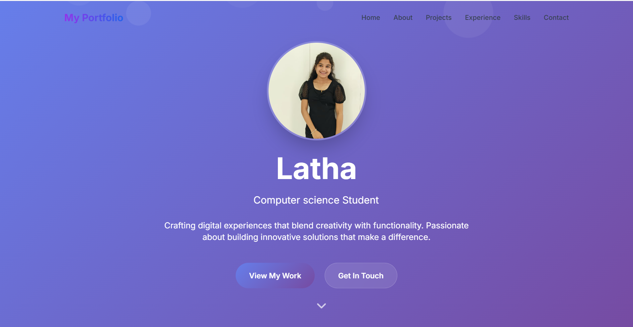
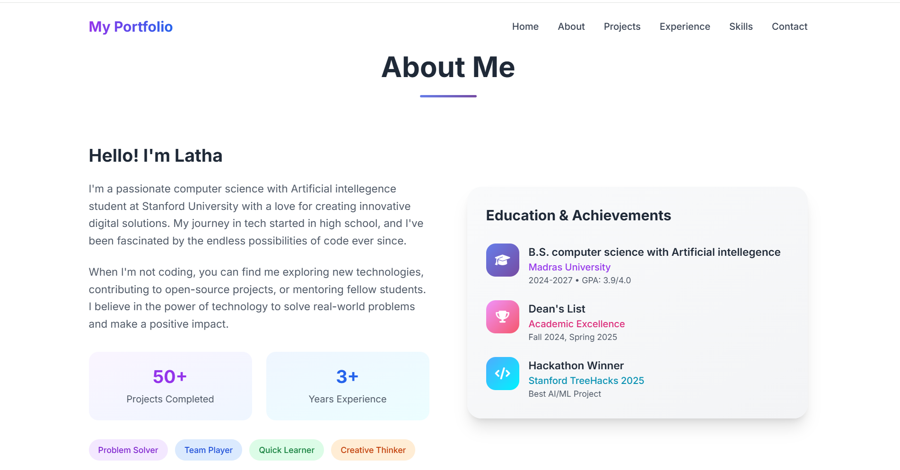
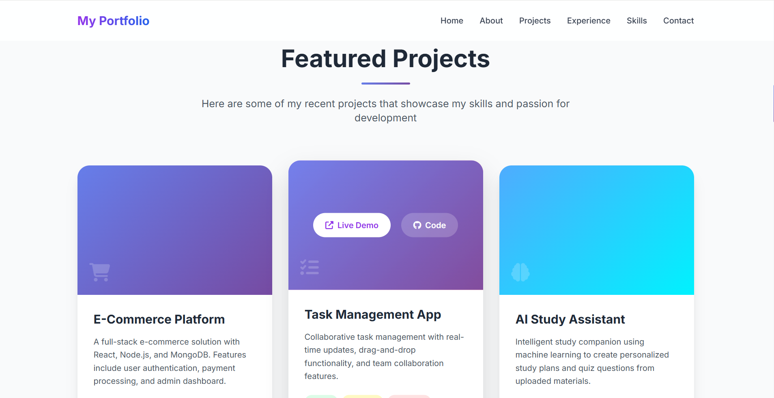
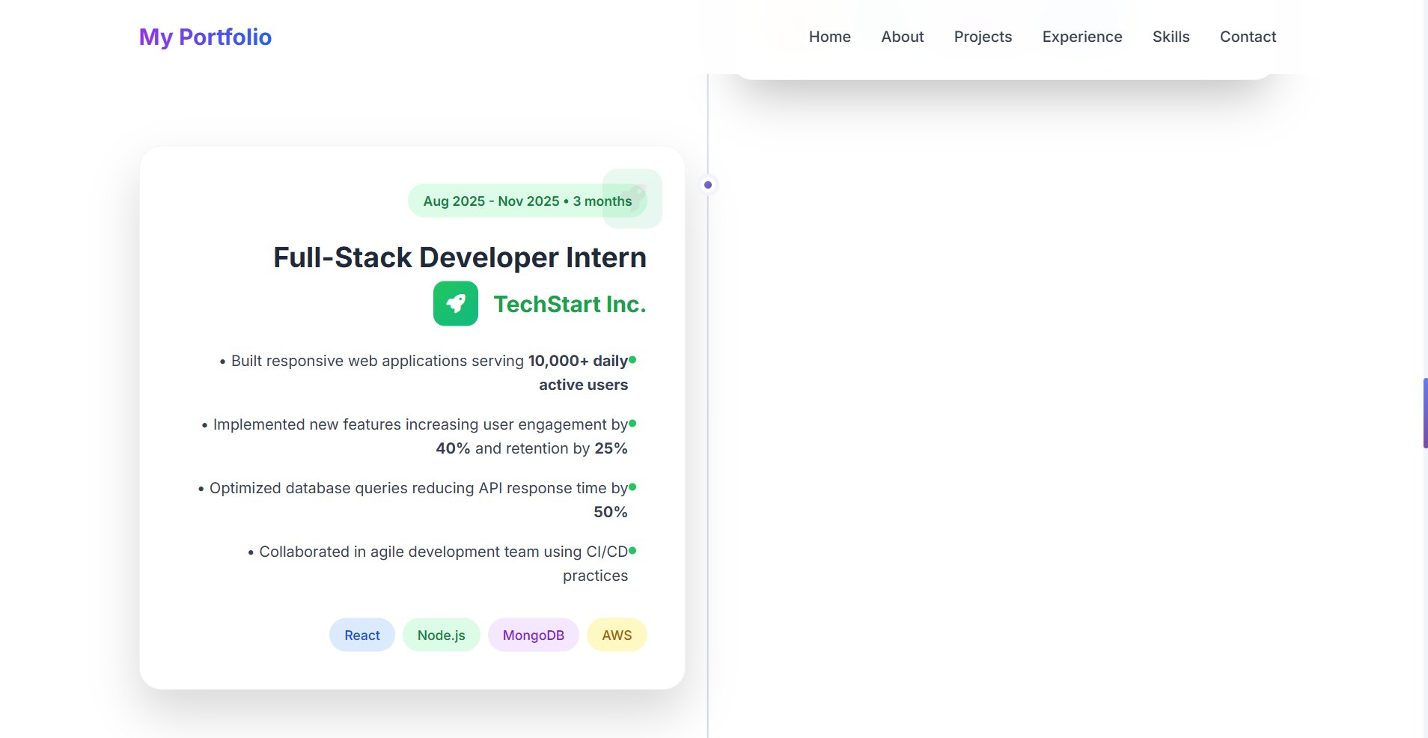
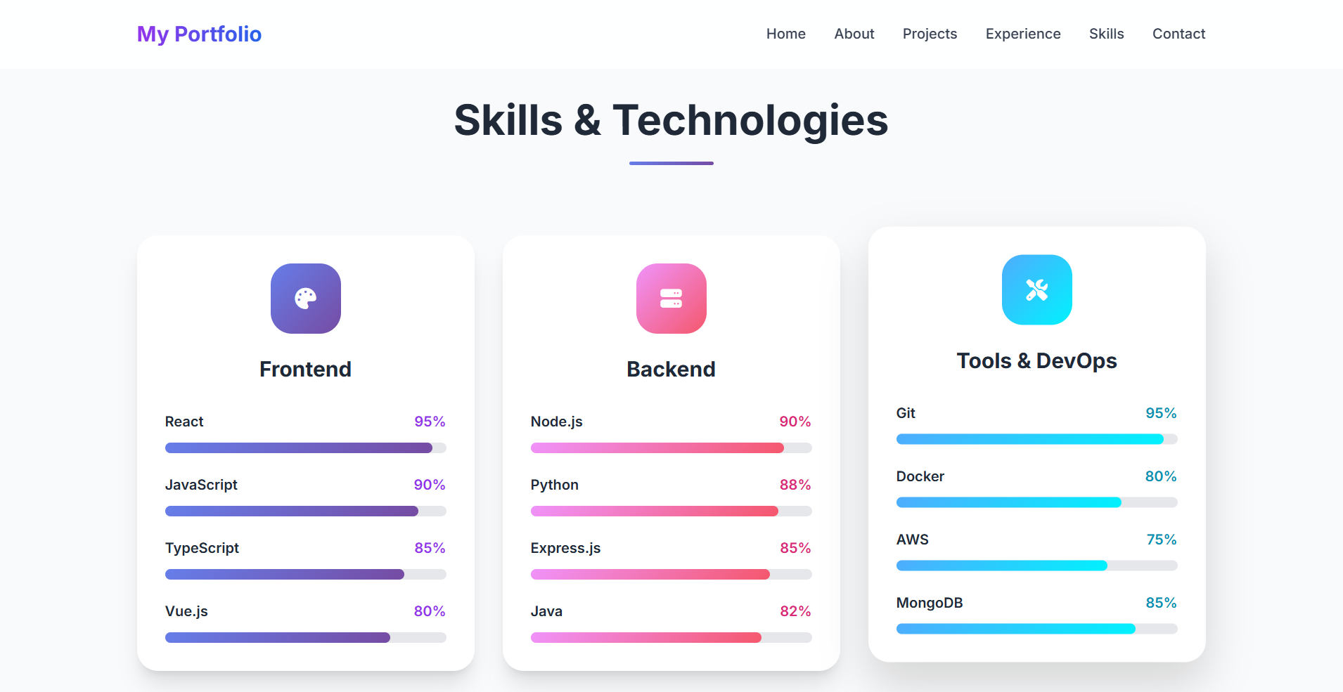
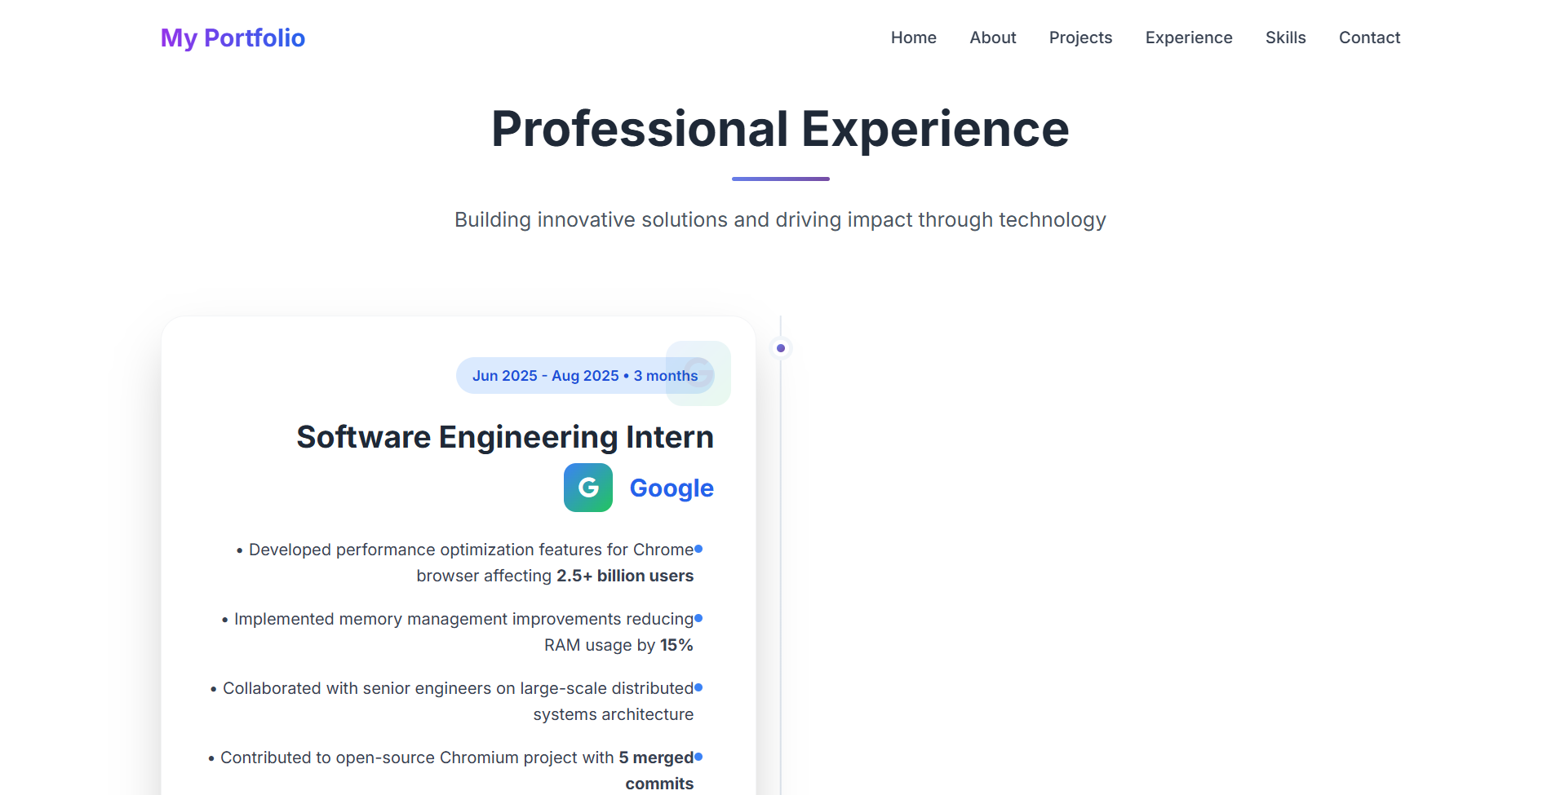
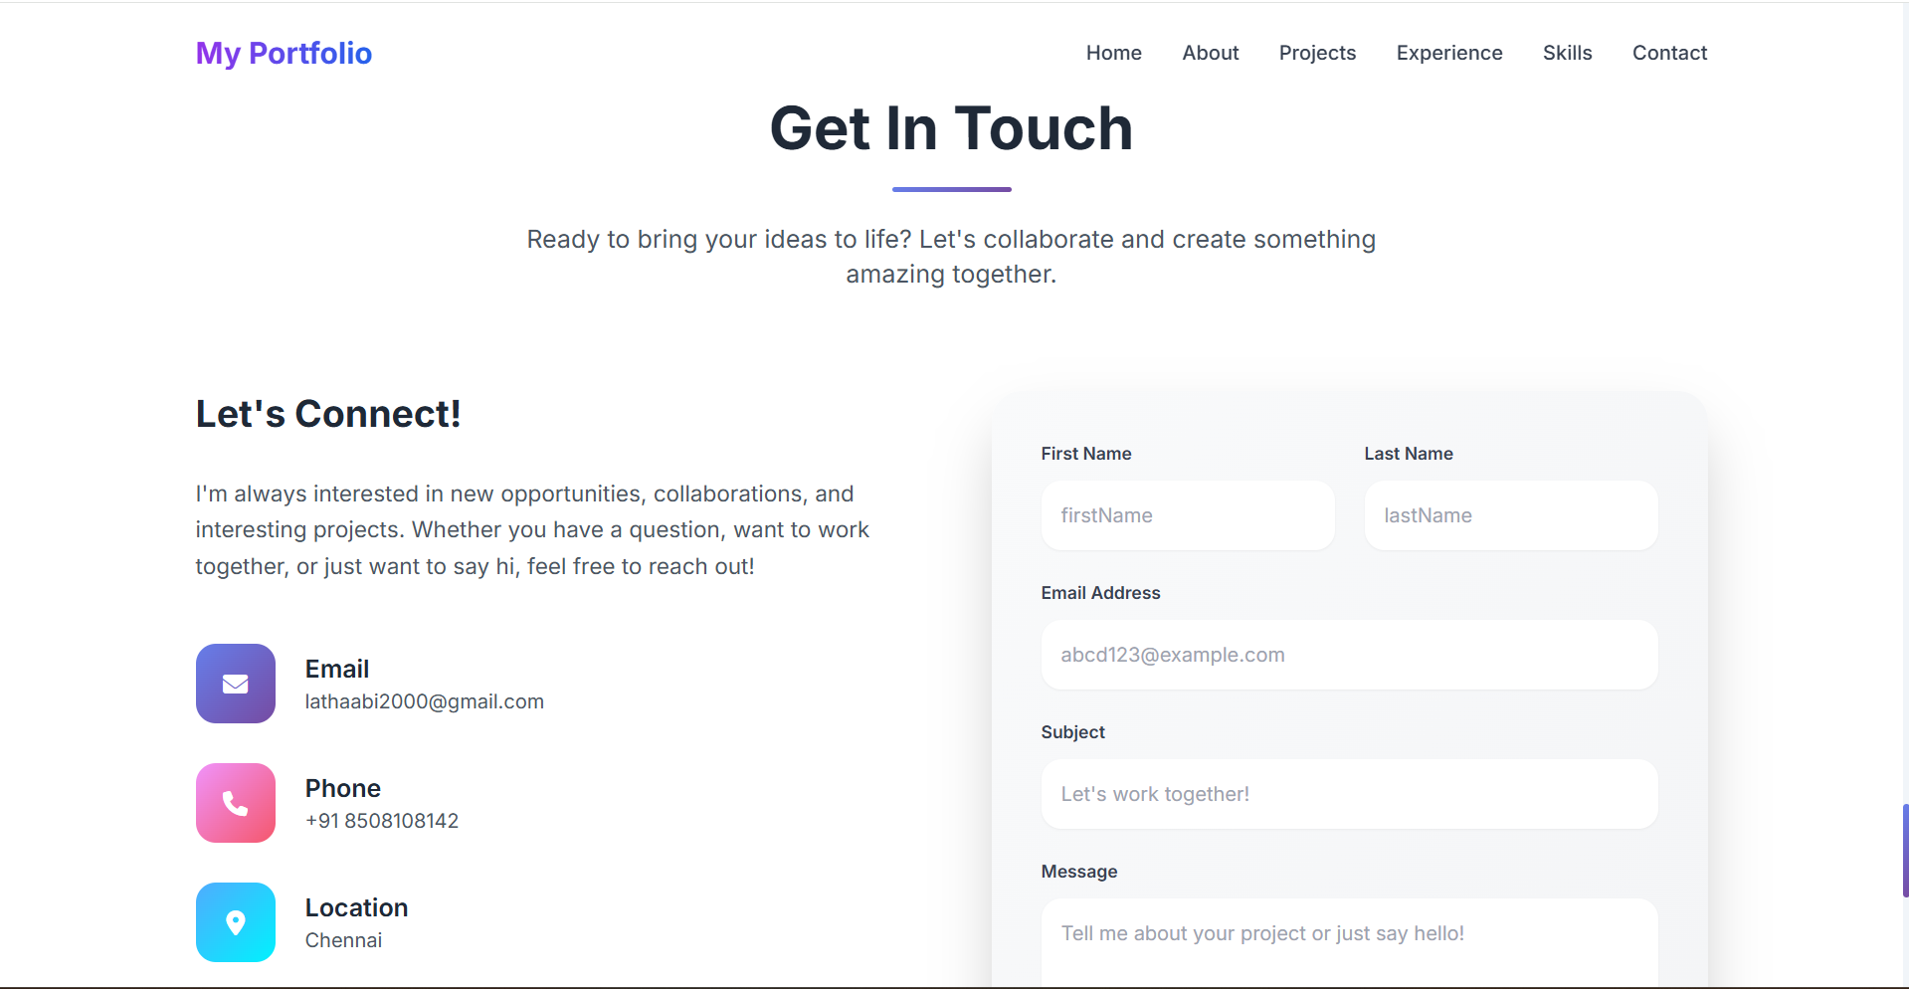
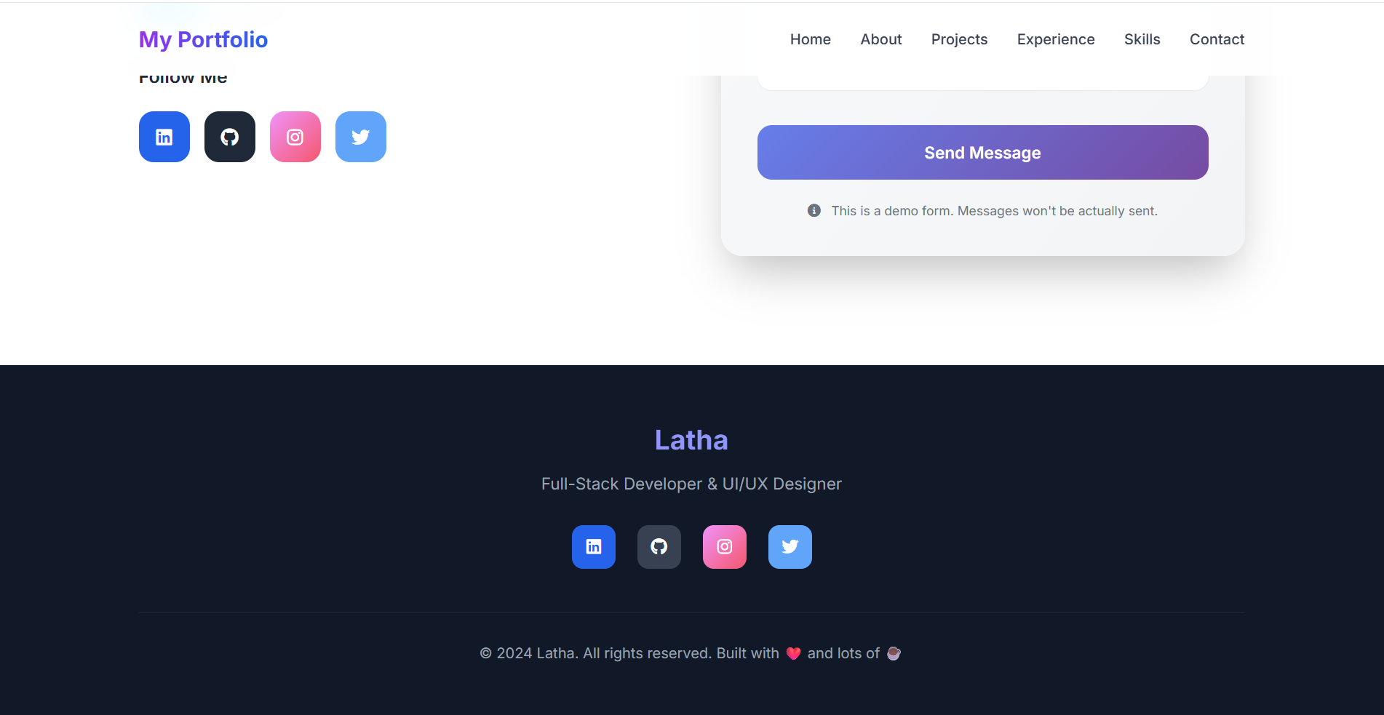
RESULTS AND SCREENSHOTS
10

Slide 11
GITHUB LINK

Slide 12
CONCLUSION
This portfolio website is a comprehensive and effective tool for launching my professional career. It successfully addresses the problem statement by:
Creating a Powerful First Impression: The modern design and smooth animations immediately convey technical competence and attention to detail.
Effectively Showcasing Your Work: The structured sections allow you to present your projects, experience, and skills in a clear, digestible manner.
Demonstrating Technical Skill: The site itself is a testament to your front-end development abilities.
Facilitating Connections: The contact form and provided information make it easy for opportunities to find you.
It's a professional, self-contained project that serves as both a showcase and a functional platform for career growth. The next step would be to populate it with your real projects, accurate experience details, and actual social media links.
12

